Slide 1
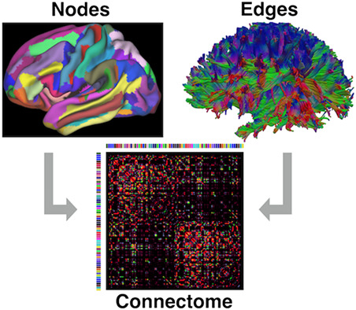


ML for Neuroimaging (CBR201: 3 credits)
4.4 Faculty and Staff Matters
Jan to April Semester - 2024

Slide 2

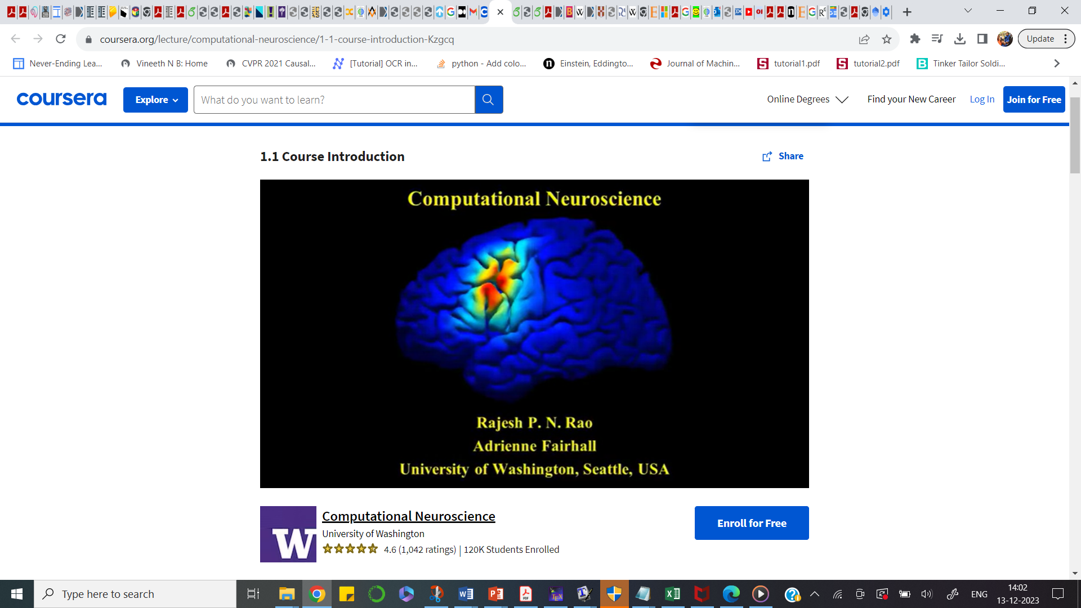
Similar courses
4.4 Faculty and Staff Matters
To ADD More

Slide 3
Reference Text books
“Introduction to Neuroimaging Analysis” by
“Introduction to Resting State fMRI Functional Connectivity ”
3.
“Machine Learning” by Tom Mitchel
“Learning from Data”, by Yaser Abu Mostafa
4.4 Faculty and Staff Matters

Slide 4
Course - Outline
Lec1, Lec 2: Neuroimaging data types (# of hrs ~ 4)
- EEG, MEG, sMRI, fMRI, Diffusion weighted MRI, PET, Infra-red spectroscopy
- Objectives of the study – 3 Case studies (EEG, sMRI, fMRI)
Tutorial #1 (Reading and Visualization of data in Python)
Lec3, Lec4 : ML basics (# of hrs ~ 3)
- ERM framework
- Learning theory
- Gaussian Distribution
- Hoeffding’s inequality
- Tutorial #2 (Generation of Simulated data from different probability distributions)
4.4 Faculty and Staff Matters

Slide 5
Course - Outline
Lec5, Lec6, Lec7, Lec8 : Regression (# of hrs ~ 7)
- Linear Model, Cost function, Regularization, GLM
- Tutorial #3 (Regression – Linear, GLM)
Lec9, Lec10, Lec11, Lec12 : Classification (# of hrs ~ 7)
- Linear classifiers, Logistic Regression, Cost function, Gradient Descent, Naïve Bayes Classifier
- Tutorial #4 (Linear classifiers)
4.4 Faculty and Staff Matters

Slide 6
Course - Outline
Lec13, Lec14, Lec15 : Neural Networks (# of hrs ~ 6)
- Perceptron
- Multi-Layer-Perceptron
- Introduction to Deep neural networks
- Tutorial #5 (NN-based classification)
Case studies (3)
Tutorial #6 (U-Net based segmentation)
Tutorial #7 (Yolo-based detection)
Lec16, Lec17 : Recent advances (# of hrs ~ 2)
- Introduction to GANs
- Causal Learning
4.4 Faculty and Staff Matters

Slide 7
Logistics
Please come with Laptops
Tutorials – coding (Python and R) assignments
Toolboxes – FSL,
In-class 5 minute presentations – All students to take turns
Jan-Feb: Quiz – 1, Paper presentation, Mid-Term Exam
March-April: Quiz – 2, Paper Implementation, Final Exam
4.4 Faculty and Staff Matters

Slide 8
ML for Neuroimaging
4.4 Faculty and Staff Matters
Let’s begin!!

Slide 9
Terminologies in ML
Task – ?
Datasets – ?
Features - ?
Training Data – ?
Validation Data - ?
Testing Data – ?
Performance ?
Model - ?
Training ?
Loss function ?
Cost function ?
Ensemble ?
Cross Entropy ?
Accuracy ?
Distribution ?
Training Error ?
Testing Error ?
Visualization ?
T-SNE Plot ?
ROC curves?
Gradient Descent ?
Supervised
Unsupervised
Self supervised
Semi supervised
Reinforcement learning
Data-driven
4.4 Faculty and Staff Matters

Slide 10




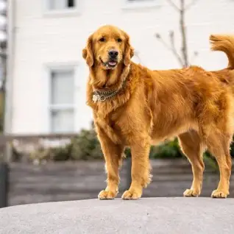

Terminologies in ML
Task – What is the Objective ?
Given 2 sets of images, say collection of Dogs and Cats
4.4 Faculty and Staff Matters

Slide 11
Terminologies in ML
4.4 Faculty and Staff Matters
If the Task is “CLASSIFICATION”, what does it mean ?

Slide 12
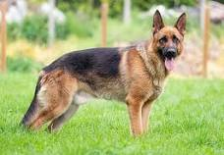
Terminologies in ML
If the Task is “CLASSIFICATION”, what does it mean ?
MODEL
DOG
4.4 Faculty and Staff Matters
MODEL
DOG
4.4 Faculty and Staff Matters
What is the difference between TOP and BOTTOM panels ?

Slide 13
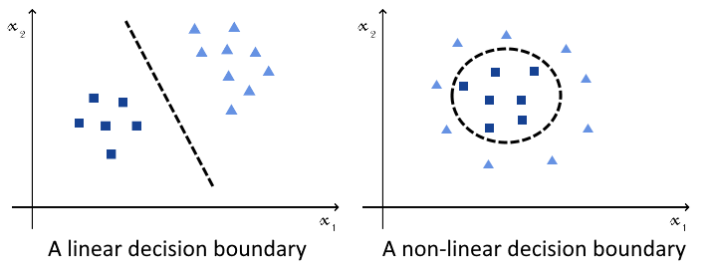
Terminologies in ML
In “CLASSIFICATION”, we “BUILD” a model, that assigns a label to a Data point
4.4 Faculty and Staff Matters
Job of the Model is to determine the boundary that separates the two classes
Say, DOGS are represented as
CATS are represented as

Slide 14
Terminologies in ML
Task – What is the Objective ?
Given 2 sets of images, say collection of Triangles and squares
4.4 Faculty and Staff Matters

Slide 15
Terminologies in ML
4.4 Faculty and Staff Matters
If the Task is “CLASSIFICATION”, what does it mean ?

Slide 16
Terminologies in ML
If the Task is “CLASSIFICATION”, what does it mean ?
MODEL
TRIANGLE
4.4 Faculty and Staff Matters
MODEL
TRIANGLE
4.4 Faculty and Staff Matters
What is the difference between TOP and BOTTOM panels ?

Slide 17
Terminologies in ML
In “CLASSIFICATION”, we “BUILD” a model, that assigns a label to a Data point
What should the feature space be ?
Feature space should allow a clear boundary
Job of the Model is to determine the boundary that separates the two classes
4.4 Faculty and Staff Matters
Plot the feature space and the decision boundary

Slide 18
Terminologies in ML
Ok. Now we got the “Decision boundary”.
How do we utilize this “Decision boundary ?
When given a new image, we should be able to say what is its label.
How ?
What are the challenges in Building a Model ?
Is a linear boundary better or a Non-linear boundary ?
What is Feature space ?
4.4 Faculty and Staff Matters

Slide 19
Choice of Feature space
What kind of Feature space is desirable ?
If classification task is: Mango Vs Apple, then what are the possible features ?
Color
Shape
Plot this feature space
4.4 Faculty and Staff Matters
Fruit | Color | Shape
Mango | Yellow | Oval
Apple | Red | Flattened sphere
Is this a good feature space ..???

Slide 20
Choice of Feature space
What kind of Feature space is desirable ?
If classification task is: Strawberry Vs Apple, then what are the possible features ?
Color
Shape
Plot this feature space
4.4 Faculty and Staff Matters
Fruit | Color | Shape
Strawberry | Red | Round
Apple | Red | Flattened sphere
Is this a good feature space ..???

Slide 21
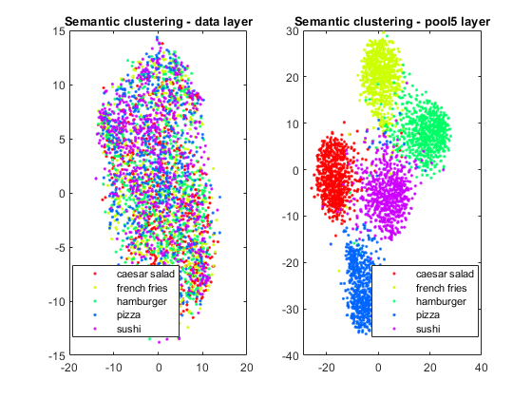
Choice of Feature space
Which feature space is better ?
Good Feature space needs
Large Inter-class distance and
Small Intra-class distance
Any golden rule to decide on the best feature space ?

Slide 22
What is Data-driven approach
Traditional ML Vs Data-driven Block schematic
Data (Features)
Task Outcome
MODEL
4.4 Faculty and Staff Matters
Data
MODEL
Features
Task
Outcome

Slide 23
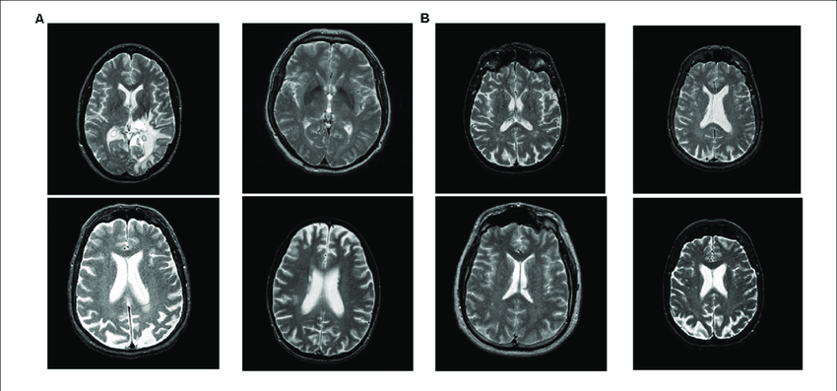
CLASSIFICATION in NI
Healthy Vs Unhealthy brains
4.4 Faculty and Staff Matters
A : UNHEALTHY B : HEALTHY
How to solve this classification problem ?
What is a good feature space ?

Slide 24
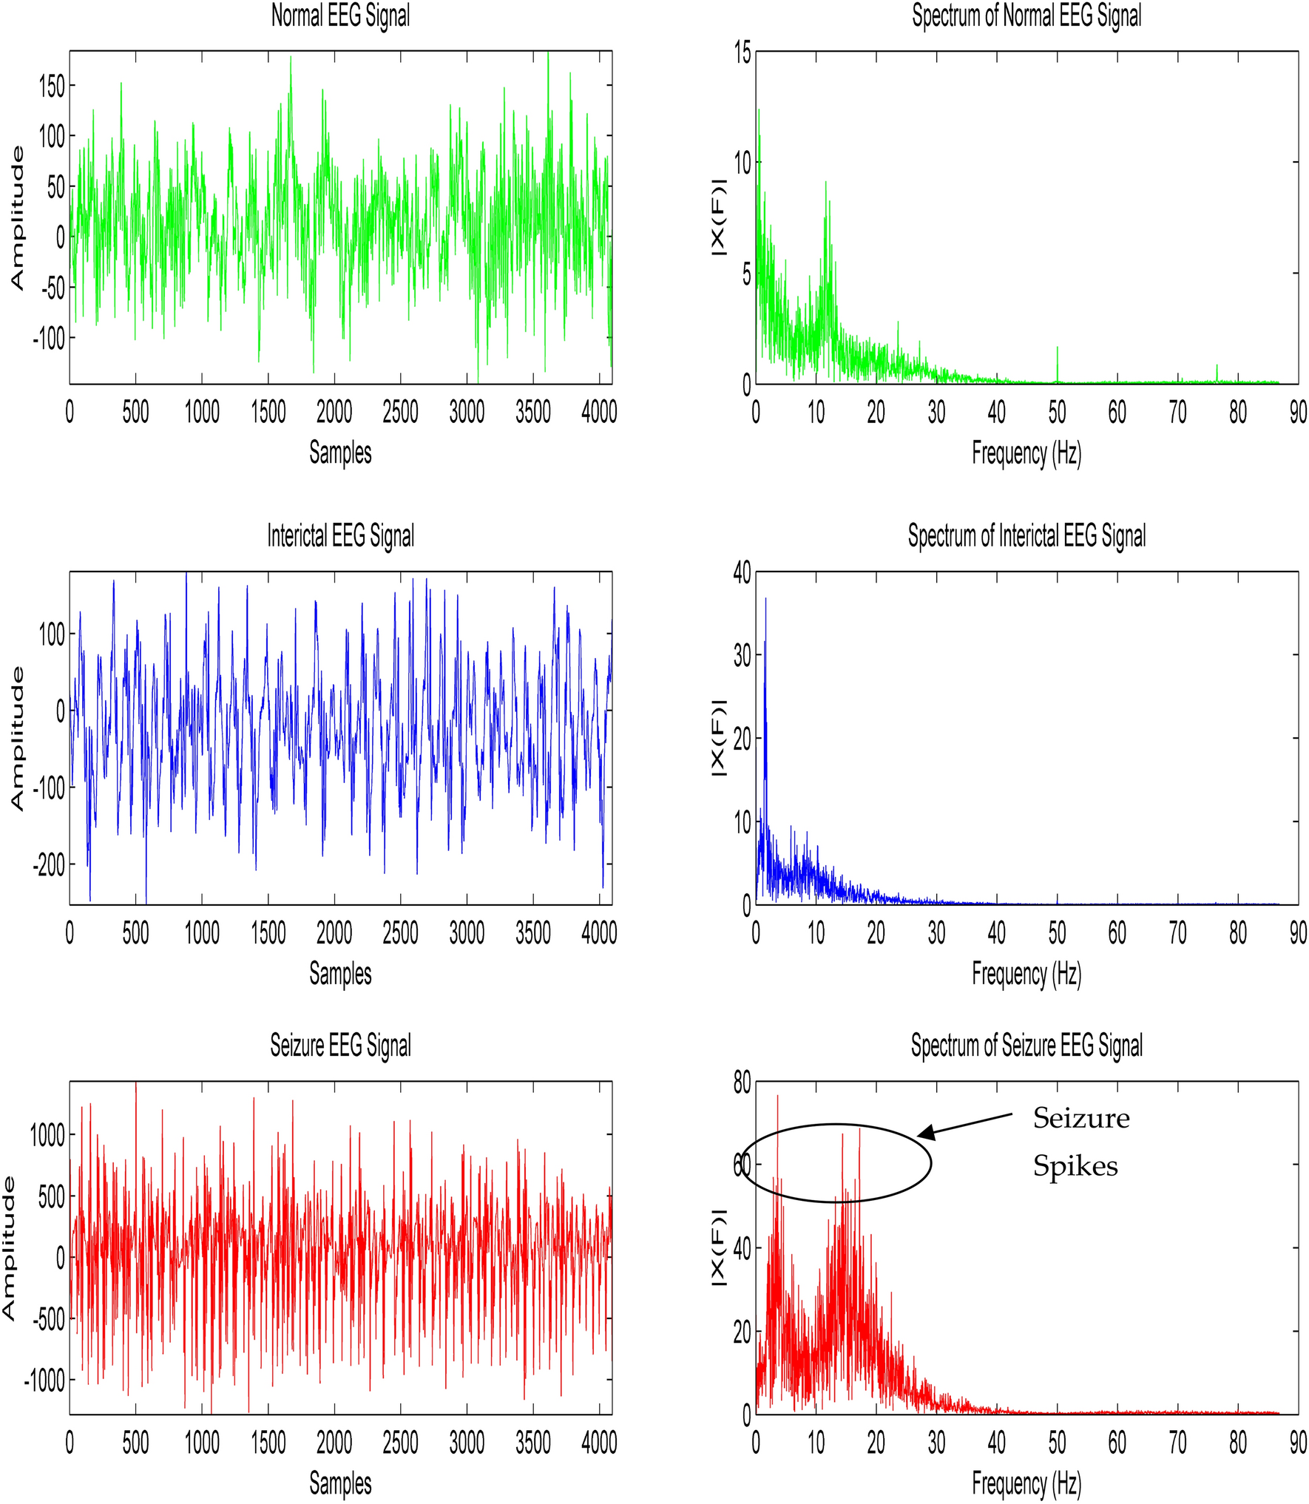
CLASSIFICATION in NI - 2
Healthy Vs Seizure – EEG Timeseries
4.4 Faculty and Staff Matters
How to solve this classification problem ?
What is a good feature space ?

Slide 25
CLASSIFICATION in NI - 2
Healthy Vs Seizure – EEG Time series in a Transform domain - Frequency
4.4 Faculty and Staff Matters
What is a good feature space ?
Which other Transform domain can be used ? Wavelet, Cosine, Hilbert,…

Slide 26
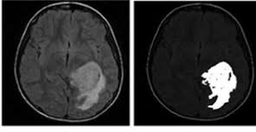
Classification Framework
For tumor segmentation
If tumor, then label =1, color=White
If Non-tumor then label =0, color = Black

Slide 27
Supervised Learning
Utilize Historical records (Data collected in the Past), labelled by experts
i.e We already know (i) How Healthy brains look
(ii) How Unhealthy brains look
(i) Normal EEG Timeseries
(ii) Seizure EEG Timeseries
(i) Tumor region in brain
(ii) Non-tumor region in brain

Slide 28
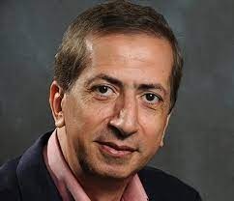
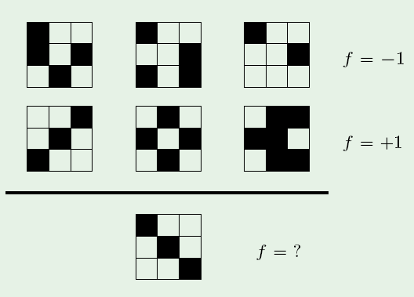
Mostafa’s Puzzle
Fun-Time
https://work.caltech.edu/lectures.html

Slide 29
Terminologies in ML
Task – ?
Datasets – ?
Features - ?
Training Data – ?
Validation Data - ?
Testing Data – ?
Performance ?
Model - ?
Training ?
Loss function ?
Cost function ?
Ensemble ?
Cross Entropy ?
Accuracy ?
Distribution ?
Training Error ?
Testing Error ?
Visualization ?
T-SNE Plot ?
ROC curves?
Gradient Descent ?
Supervised
Unsupervised
Self supervised
Semi supervised
Reinforcement learning
Data-driven
4.4 Faculty and Staff Matters

Slide 30
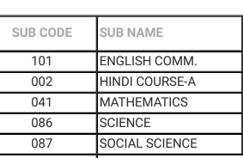
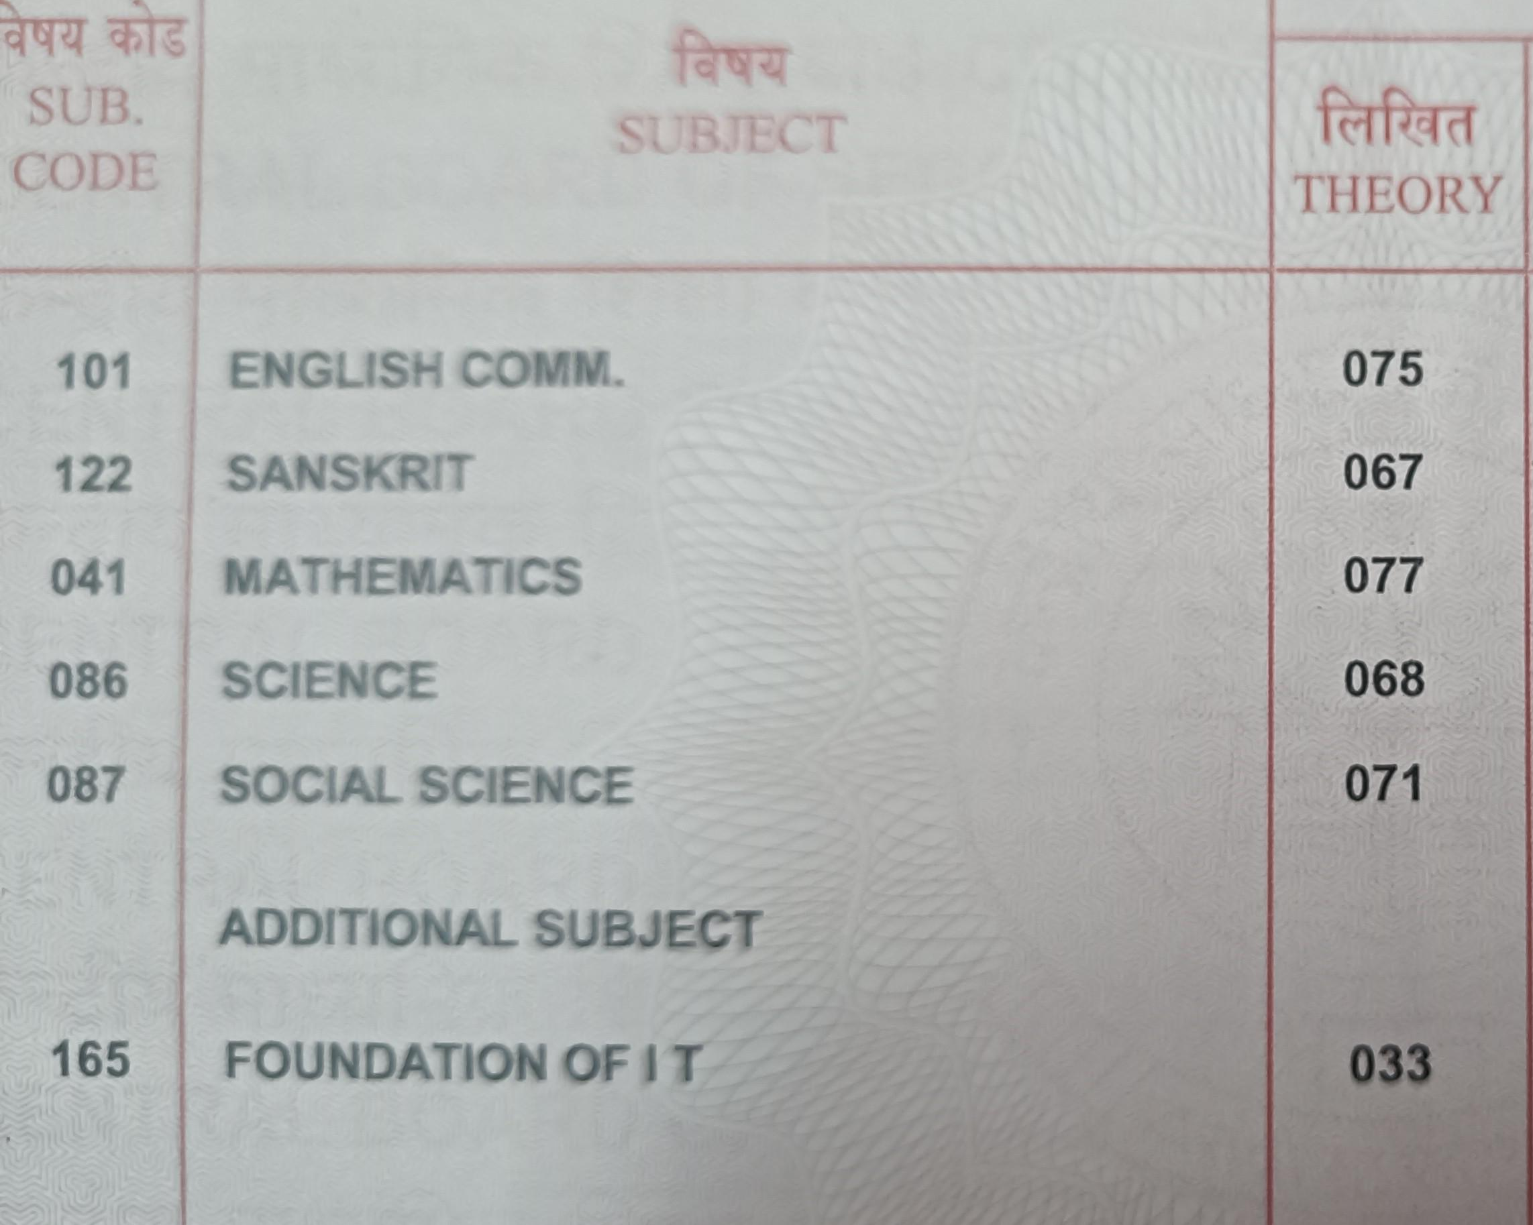
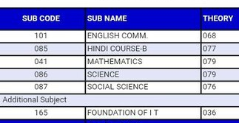
Terminologies in ML
Task – What is the Objective ?
Given a collection of 10th Std marks, Predict 12th Std Marks
4.4 Faculty and Staff Matters
Here, we need to build a Model that takes as input 10th std marks and gives as output 12th std marks
This is called “Regression”
The Output is NOT a label; It is a Real number

Slide 31
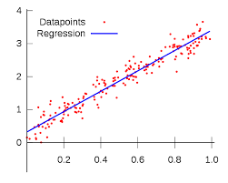
Regression
Most popular Regression – Linear Regression
What is given :
Tuples of Data : (x₀,y₀), (x₁,y₁)…….. (x_{N},y_{N}), assuming we have “N” records of the data
We assume that there’s a linear relation between x and y
i.e. we want to model them as : y = mx + c
But which line is better suited for the given data..?? How to answer this question ??
4.4 Faculty and Staff Matters
How many straight line fits are possible ?
How do we choose the optimal one ?

Slide 32
Regression
Given a collection of 10th Std marks, Predict 12th Std Marks
4.4 Faculty and Staff Matters
Model
10th std Marks
12th std Marks
Plot the graph
How many parameters determine the model ? How to determine the goodness of the model ?

Slide 33
Regression Example
Body Fat Percentage Estimation
Given Gender, weight, height, waist, neck determine Body Fat Percentage
How to solve this regression problem ?
What is the Input?
Plot Feature space
4.4 Faculty and Staff Matters

Slide 34
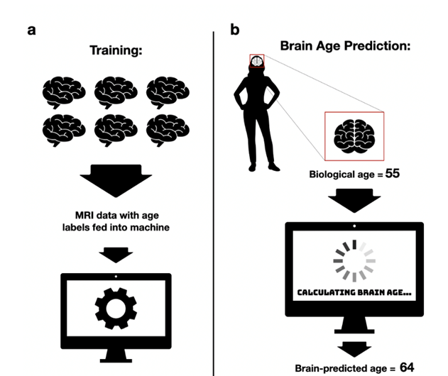
Regression Example
Brain Age Estimation
4.4 Faculty and Staff Matters

Slide 35
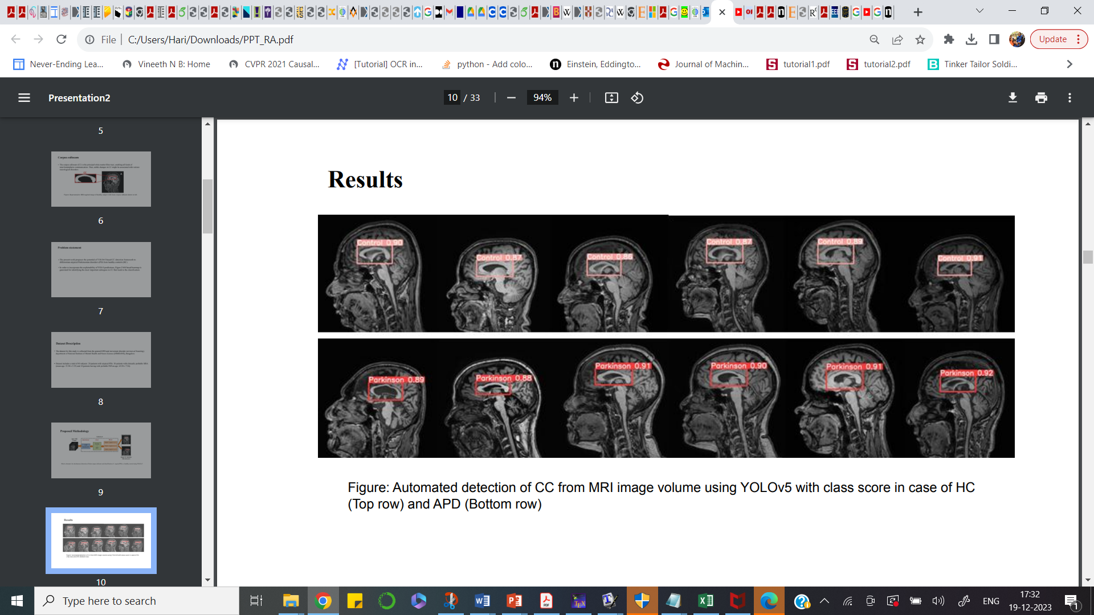
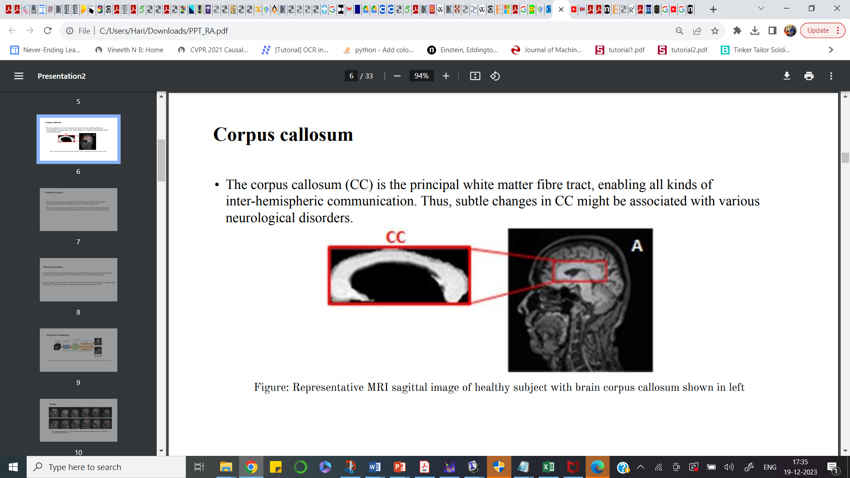
Regression Framework
Object Detection – Corpus Callosum detection
Draw a tight, rectangular bounding box encompassing CC
4.4 Faculty and Staff Matters
How to solve this regression problem ?
What is the Input? What is the Training Data ?

Slide 36
Terminologies in ML
Task – ?
Datasets – ?
Features - ?
Training Data – ?
Validation Data - ?
Testing Data – ?
Performance ?
Model - ?
Training ?
Loss function ?
Cost function ?
Ensemble ?
Cross Entropy ?
Accuracy ?
Distribution ?
Training Error ?
Testing Error ?
Visualization ?
T-SNE Plot ?
ROC curves?
Gradient Descent ?
Supervised
Unsupervised
Self supervised
Semi supervised
Reinforcement learning
Data-driven
4.4 Faculty and Staff Matters

Slide 37
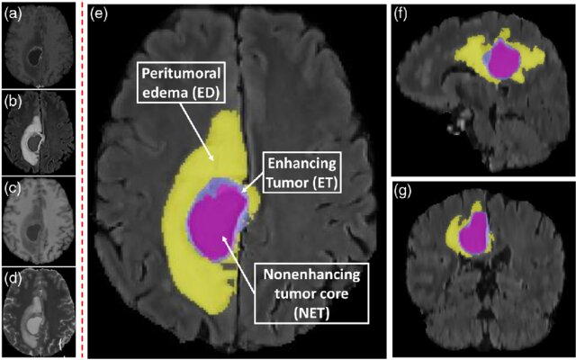
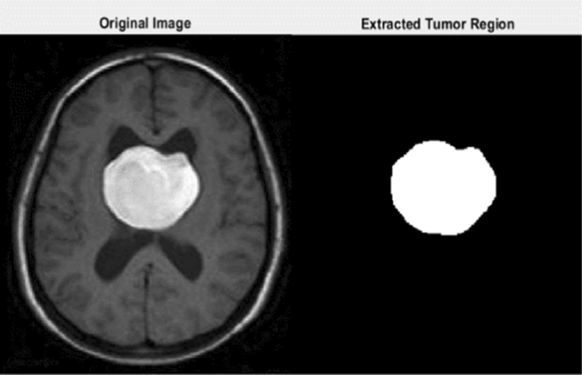
Clustering
Task – Clustering
Identify regions with similar characteristics
4.4 Faculty and Staff Matters
No Labelled Data is necessary
What is the difference between Clustering and Classification ?

Slide 38
Clustering
Task in “Unsupervised” Paradigm, unlike Classification which is “Supervised”
Most Popular technique for Clustering – “K-Means algorithm”
Applications of clustering
Given a collection of data-points, how many natural clusters are present
In spite of not knowing anything apriori about the data
2. How much similar or dis-similar are the sub-groups in each cluster?
4.4 Faculty and Staff Matters

Slide 39
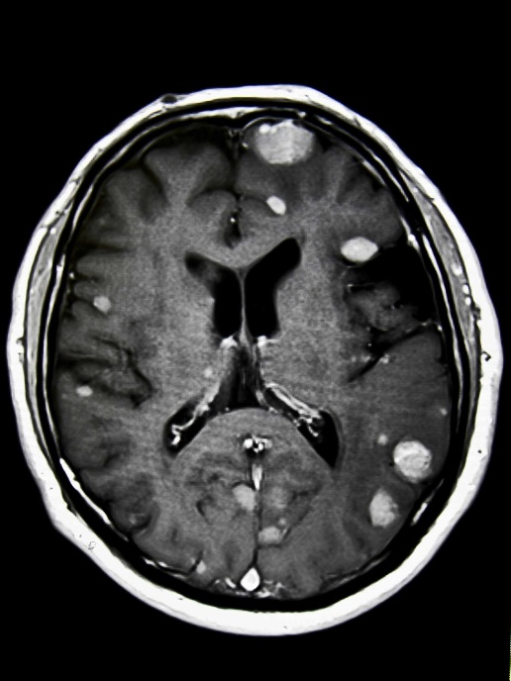
Clustering in NI
Find Tumor cluster (May be single chunk, multiple chunks)
Find sub-regions within a tumor
4.4 Faculty and Staff Matters

Slide 40
Dimensionality Reduction
Most Popular technique – PCA
What does “Dimensionality Reduction mean” ?
Data Dimension involved when we consider brain volumes
Structural brain volume: 256 x 256 x 100
fMRI time series: 128 x 128 x 100 x 200
Available instances will be ~ 50
Number of Data instances << Data dimension
4.4 Faculty and Staff Matters

Slide 41
Dimensionality Reduction
Most ML algorithms are suited for
Number of Data instances >> Data dimension
Besides, intuitive understanding, computation feasibility, memory requirements are “Managable” when Data dimension is lower
So, even if we don’t have any annotated data, it is possible to perform “Dimensionality Reduction” – Example of “Unsupervised” learning
4.4 Faculty and Staff Matters

Slide 42
Lets get started with some ML now!!
4.4 Faculty and Staff Matters

Slide 44
Some Useful Concepts

Slide 45
Calculus Recap
Given a function, what does the derivative say ??
How to minimize a function ?
2 important approaches : (i) Closed form (ii) Iterative
What is constrained ? Unconstrained minimization ?
Notes:
Welcome to the lecture on ””

Slide 46
Examples
Say, we want to minimize
y = 4x² + 2
Plot the function :
dy/dx = 8x
Put dy/dx = 0 , it implies x = 0
So function is minimum at x = 0
This is the closed form solution

Slide 47
Examples
Say, we want to minimize
y = 4(x-5)² + 2
Plot the function :
dy/dx = 8(x-5)
Put dy/dx = 0 , it implies x = 5
So function is minimum at x = 5
This is the closed form solution

Slide 48
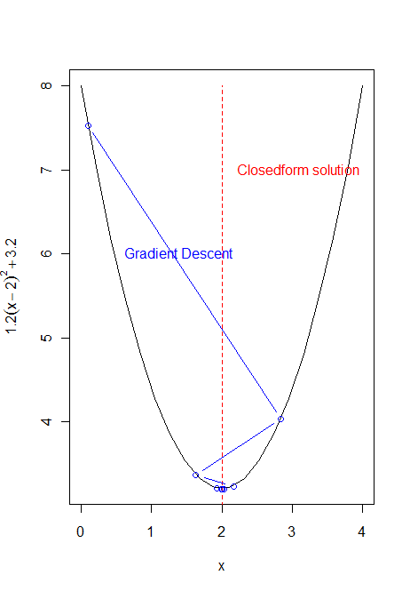
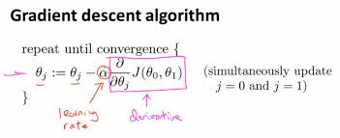
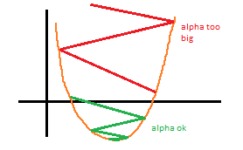
Iterative minimization

Slide 49
Iterative Minimization
y = 4(x-5)² + 2
dy/dx = 8(x-5)
Say x_old = 4
X_new = x_old + alpha (dy/dx)|at x = x_old
X_new = 4 + 0.1(8*(4-5)) = 4 – 0.8 = 3.2
X_new = 3.2 + 0.1(8*(3.2-5)) = 3.2 - 1.28
Check HHHHHHHHHHHHHHHHHHHH

Slide 50
Quick exercise
E = 1.2(x-2)² +3.2
x_{opt} = 2
Work out the close-form solution
Work out x⁽¹⁾, x⁽²⁾ results of two steps of gradient descent

Slide 51
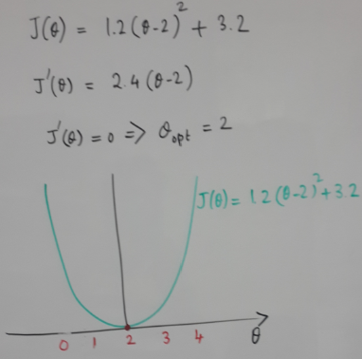
FN MINIMIZATION
CLOSED FORM

Slide 52
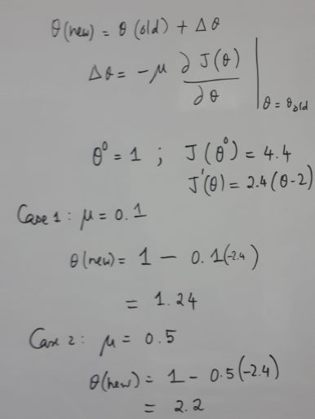
Iterative method
GRADIENT DESCENT

Slide 53
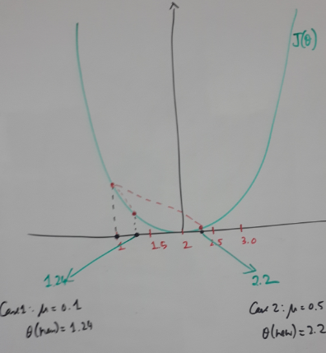
Gradient Descent
GRADIENT DESCENT

Slide 55
Fitting a straight line
Notes:
Welcome to the lecture on ””

Slide 56
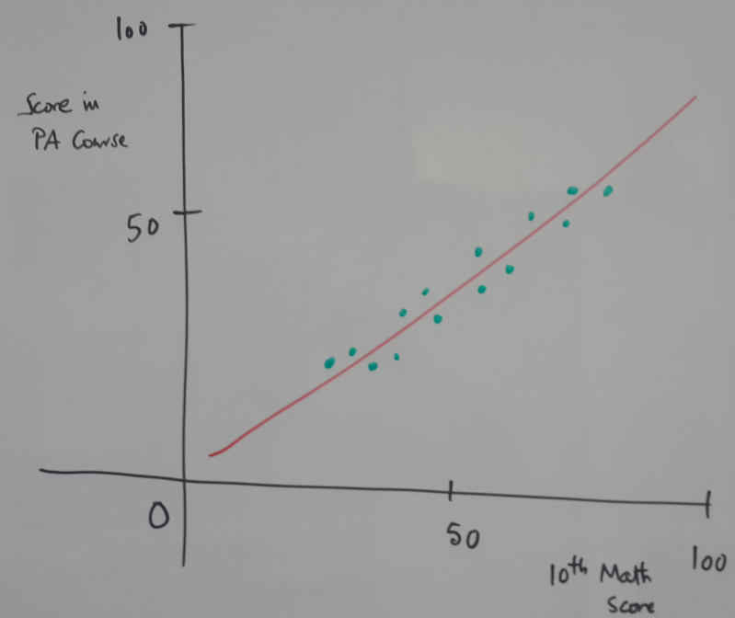
Fitting a straight line

Slide 57
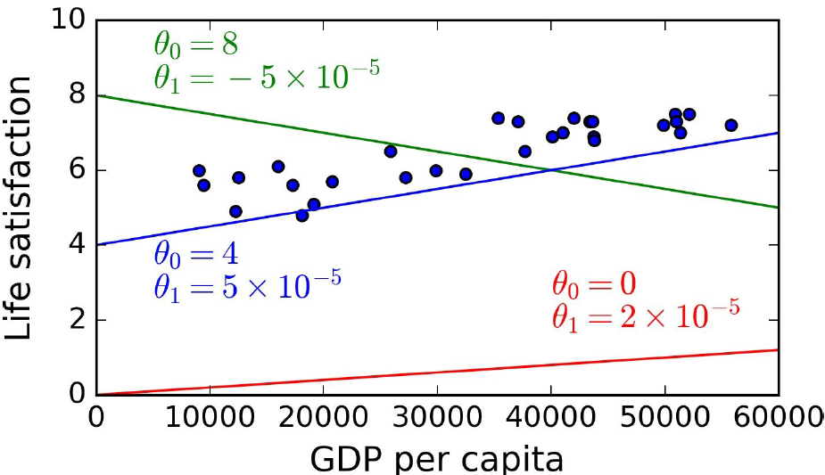
Example problem

Slide 58
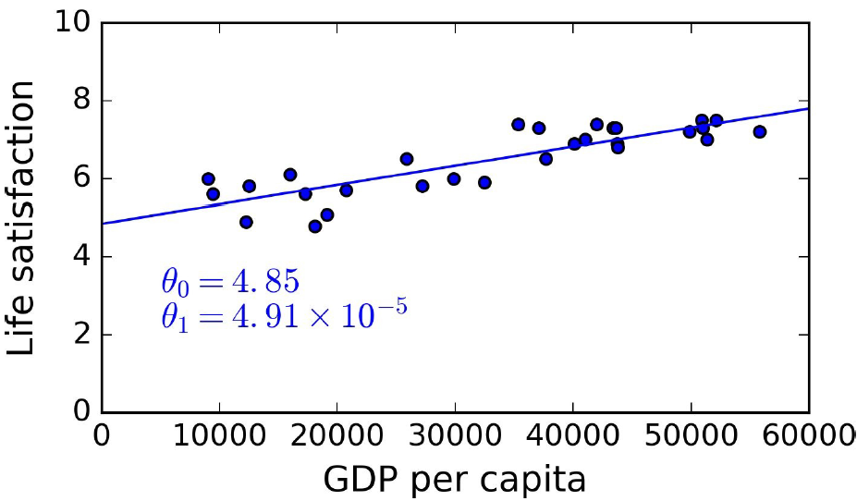
Example problem

Slide 59
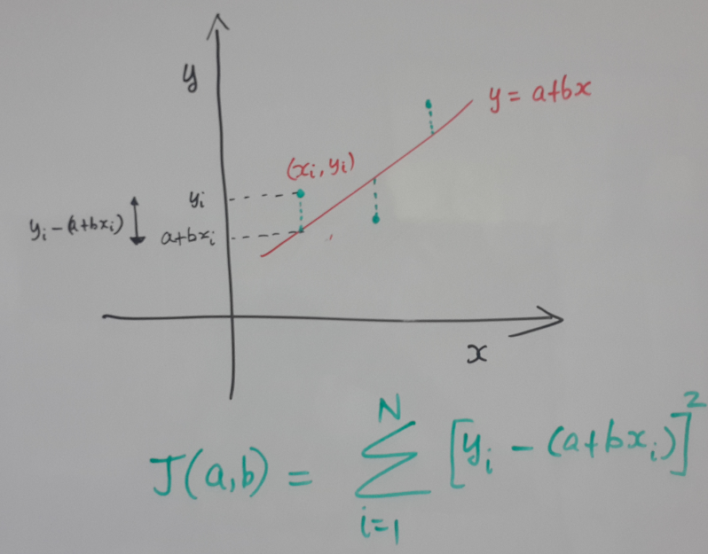
Fitting a straight line – Cost function

Slide 60
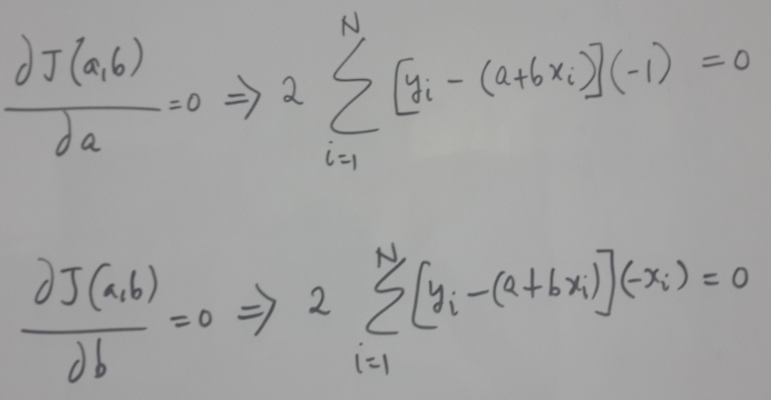
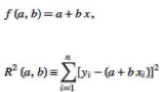
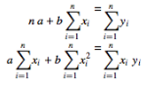
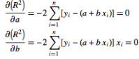
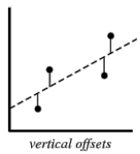
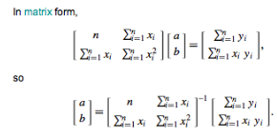
Closed form – Minimize sum of square error
Pseudo-inverse

Slide 61
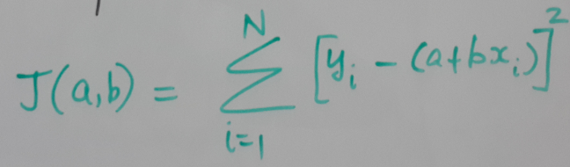
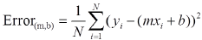
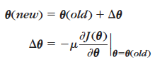
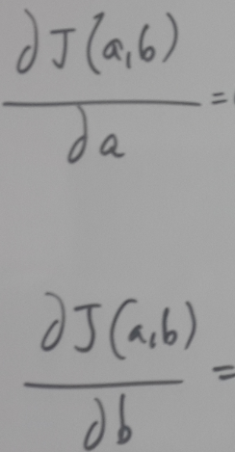
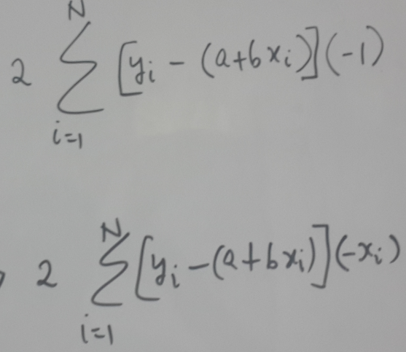
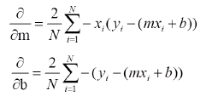
Gradient Descent – Minimize sum of square error
Notes:
Here again we compute the gradient. Then update
b as follows:
a as follows:
mu is parameter that needs to be chosen at the beginning
of our procedure.

Slide 62
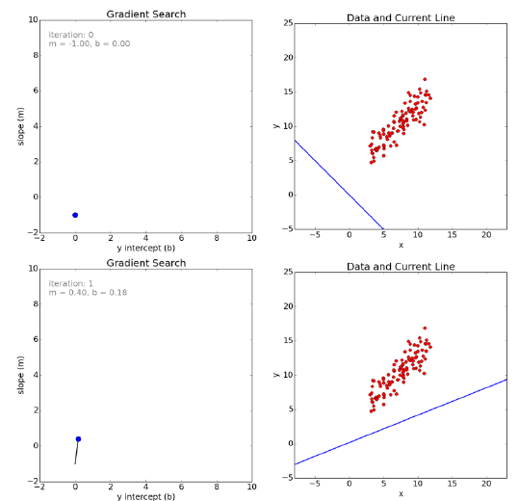
Gradient Descent
Notes:
After several iterations, we can see that we reach the minima,
and the corresponding model parameters fit the given the data
points the best.

Slide 63
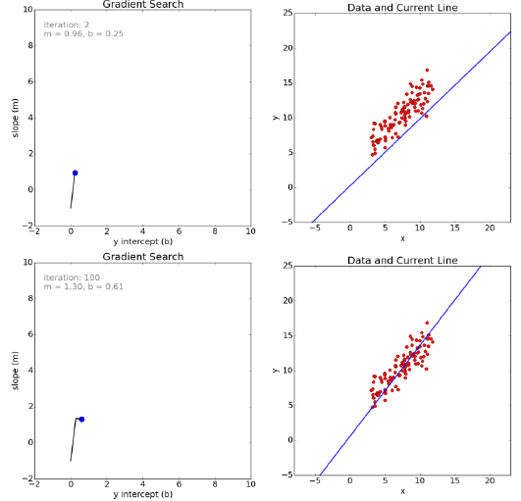
Gradient Descent

Slide 64
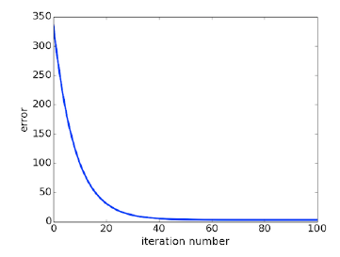
Convergence

Slide 65
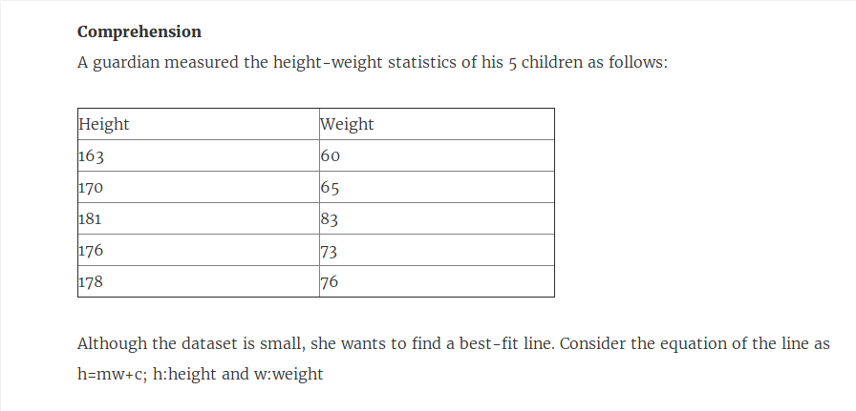
Sample problem

Slide 66
Notes
There are variations of gradient descent for example Newton's method which need more computations, but converge quickly.
Also, we note that when we need to maximize a function instead of minimizing, we can reuse the same principles.

Slide 67
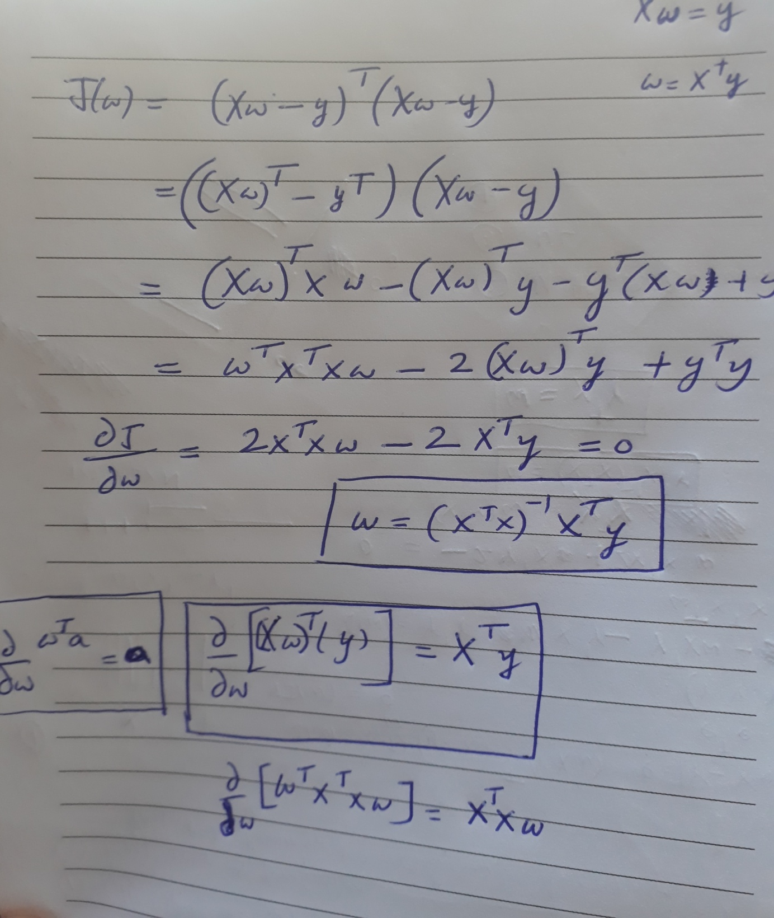

Slide 68
fitting a gaussian
Notes:
Welcome to the lecture on ””

Slide 69
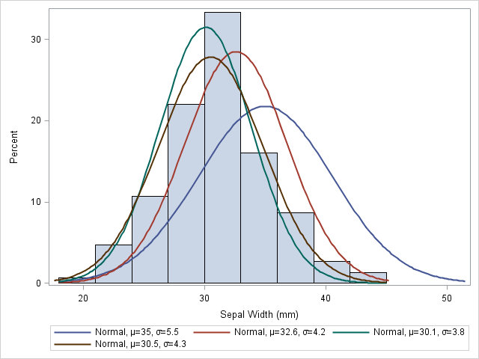
Which Gaussian is the best? and how to get to it?
Hair length
of women

Slide 70
Maximum likelihood function
Let us define a cost function in terms of the parameters to be estimated
We should find that value of parameter which maximizes the probability of observing the given N samples

Slide 71
Maximum likelihood
Assuming the samples are independently drawn
Take logarithm (makes our life easier for further steps; as it is a monotonic function, we are allowed to do so)

Slide 72
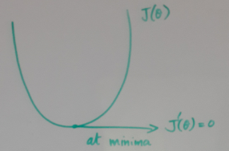

Maximum likelihood (closed form)

Slide 73
ML – single dimensional Gaussian

Slide 74
ML – single dimensional Gaussian

Slide 75

Simple Example

Slide 76


Slide 77


Slide 78


Slide 79
Linear Models
From the Hypothesis set, we are choosing only those that are Linear !!

Slide 80
Perceptron – Why?
Perceptron – an early iterative algorithm to calculate the straight line parameters (one of the earliest Machine Learning Algorithm)
Link to Support Vector Machines (SVM)

Slide 81
Perceptron -Wiki
Invented in 1957 by Frank Rosenblatt
"the embryo of an electronic computer that [the Navy] expects will be able to walk, talk, see, write, reproduce itself and be conscious of its existence."
In 1969 a famous book entitled Perceptrons by Marvin Minsky and Seymour Papert showed that it was impossible Perceptron to learn an XOR function.

Slide 82

Perceptron

Slide 83


Slide 84


Slide 85


Slide 87
Perceptron inference algorithm
Given this straight line, say we have learnt, the inference algorithm is simple. On the straight line x₁-x₂ = 0; If x₁-x₂ > 0, then RED class; x₁-x₂ < 0 BLUE class
x₁-x₂ < 0
x₂
x₁-x₂ = 0
x₁-x₂ > 0
x₁

Slide 88


C. What the perceptron learning algorithm aims to do..
In this diagram, we
have blue points and
the gray points (two
classes)
Assume we start with
the dotted line,
x₁+x₂ -0.5 = 0;
we will classify two
points wrongly, one blue
point and one gray point

Slide 89
C. What the perceptron learning algorithm aims to do..
The perceptron allows
you to move to a line
which separates the
points correctly and
therefore move to the
dark line,
1.42x₁+0.51x₂ -0.5 = 0;
This line has zero
Classification error

Slide 90

C. Augmented representation (points and lines)

Slide 91
C. What is the Perceptron algorithm

Slide 92

Weight correction (blue to black)

Slide 93



D. Perceptron Learning Algorithm: Minimizing a certain cost function
Cost function
Gradient Descent

Slide 94
Perceptron - Drawbacks
It may take too many iterations
Works only if data is linearly separable
………………

Slide 95

Linear Classifier : Perceptron
Works if Data is linearly Separable
Perceptron Realisation

Slide 96
Perceptron on MNIST

Slide 97


Slide 98

Features
Which scenario is better ?? Using 256 Features or Using 2 features ??
Why ???

Slide 99

Scatter-plot of Data in Feature space

Slide 100

Iterations : PLA
Notice : Difference in the Decision boundary !!
Bottomline : Algorithm converges if Data is linearly separable !!

Slide 101


Linear Regression (Real-valued output)

Slide 102

Linear Regression - Objective

Slide 103

Cost function
Please Remember :
Training Error = In-sample error
Testing Error = Out-of-sample error

Slide 104

Cost function contribution
Notice : All data points that are not on the line contribute to the cost function

Slide 105

Cost function - Rewriting
Notice : All data points x₁, x₂…..x_{N} contribute to the cost function

Slide 106
Vector calculus - Hints
Given that w is a vector and U is a matrix/vector
(1) d/dw (U^{T}w) = U
(2) d/dw (w^{T}Uw) = 2Uw

Slide 107
Error measure, J = ||y-Xw||²
J = (y – Xw)^{T}(y-Xw), Expanding Norm ||y-Xw||²
^{Expand the brackets :}
J = [y^{T} – (Xw) ^{T}][y – Xw]
= yTy- (Xw)Ty- yTXw + (Xw)T (Xw)
^{= yTy - 2 yTXw + wTXTXw}
dJ/dw = 0 – d/dw(2 yTXw ) + d/dw(wTXTXw)
^{= -2 (yTX) T + 2 XTXw}

Slide 108
Setting dJ/dw = 0
^{-2 (yTX) T + 2 XTXw = 0}
^{(yTX) T =} ^{XTXw}
^{XTXw = (yTX) T = XTy}
^{w} ^{= (XTX) -1 XT}
Hence w is the Pseudo Inverse of X

Slide 109


Slide 110

Pseudo-inverse Dimensions
Think : What if “d” was a large number ?!?

Slide 111

Notice : All Data points are dealt with, in one shot !!

Slide 112


Linear Regression - Classification
Classification is a special case of Regression !!!
Regression can be utilized to achieve Classification !!

Slide 113

Linear Models - Summary
Remember : The “x” values are frozen; The unknowns are “w”

Slide 114
Logistic Regression

Slide 115



Linear Models – Contd…
Note : The logistic function behaves “linearly” in a certain interval ; It behaves like the Signum function at the tails

Slide 116

Logistic (Sigmoid) function
Where,

Slide 117

Logistic (sigmoid) function

Slide 118
Logistic (Sigmoid) function
Maps real line to [0,1]
Can be used to model posterior probability i.e P(C | x)
Final goal: Feature as input and output as posterior probability,
using the sigmoid model
Step 1: Take linear combination of features (similar to Linear Regression)
Step 2: Apply sigmoid function

Slide 119

Logistic Regression
Where,
What happens when -----
Risk score is high ?? s is large; Ɵ(s) -> 1
Risk score is low ?? s is small; Ɵ(s) -> 0

Slide 120

From Discrete to Real-valued
Data tuples given (x,y) represent :
x = [Age, cholesterol level, weight]
y = +1 (Had a heart attack) or -1 (Didn’t have a heart attack)
But we would have wanted the “Probability of Heart Attack” given the Pattern x
If “f” is the IDEAL function that takes in input Pattern “x” and outputs the probability that the pattern “x” will lead to a Heart Attack

Slide 121

How to quantify the error ?
For each (x,y), y is generated by probability f(x)
We are trying to learn “f”
If we use “h” as approximation to “f”, it means
If h = f, how likely are we to get y from x

Slide 122







MLE - Estimation
Given pattern “x”, what is the likelihood that “y” is generated by “h” :
Re-writing P(y|x), using odd symmetry about 0.5

Slide 123




Maximizing the Likelihood
Maximize
Maximize the log
Maximize scaled version
Minimize
Same as minimizing

Slide 124


MLE
Error Measure =
Re-write the Error Measure, expanding Ɵ
If (y_{n}) and (w^{T}x_{n}) have same sign, then it contributes e^{-ve} number ;
Hence contribution is small (i.e Hypothesis is correct for that point)
If (y_{n}) and (w^{T}x_{n}) have opposite signs, then it contributes e^{+ve} number ;
Hence contribution is large (i.e Hypothesis is wrong for that point)
Hence we need to minimize the Error Measure
Objective : Find that parameter “w” that minimizes the Error measure

Slide 125


MLE
We got a closed form solution !!
Closed form solution not possible ☹
Way ahead : Iterative solution

Slide 126



Gradient Descent
Initialize w as w(t)
Differentiate Error wrt w :

Slide 127
Conclusion
Logistic Regression
Classifier: Logistic idea + Linear Regression
Discriminative model (vs Generative model)
Parameters – feature weights
Estimation – ML estimation
Gradient Descent (Iterative Method)

Slide 128

Linear Model Summary

